Slide 1
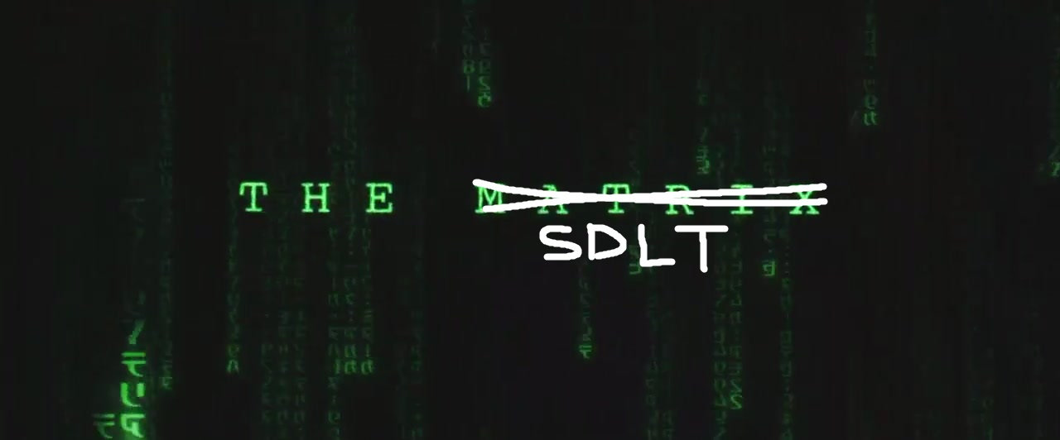

Slide 2
Who am i?
Who am I?
Scott Rasmussen
What do I do?
Software and Security Architecture
Where to find me?
Scott.Rasmussen@nzta.govt.nz
Social media?
I’m not that interesting

Slide 3
What to expect
20 year anniversary for ‘The Matrix’
Bad Matrix puns/jokes/references
Lots of pretty pictures
Some stuff about the SDLT
Note: I am not Keanu Reeves. I’m also sorry for using references from the Matrix 2 and 3… they’re both terrible.

Slide 4
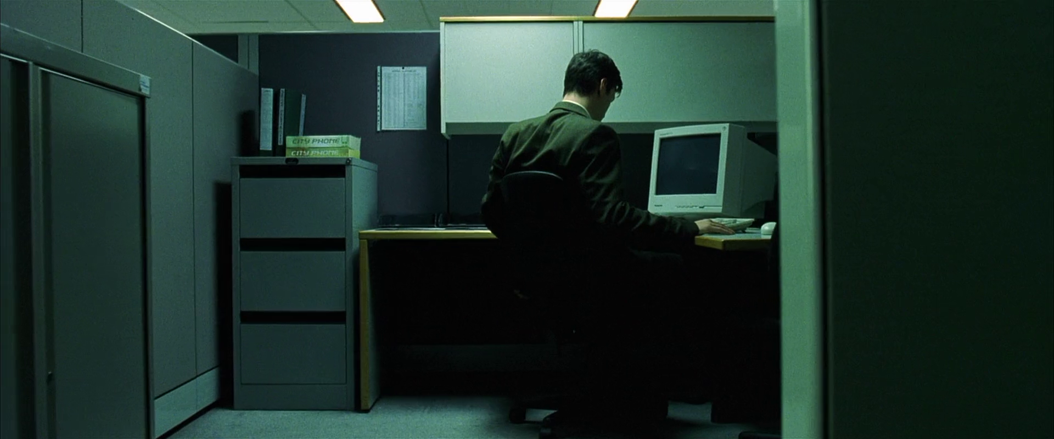
Working as solutions architect
for assessment

Slide 5
Asked to join security team
for assessment

Slide 6
Now I was outside the system
for assessment

Slide 7
No guidance, asked to jump
for assessment

Slide 8
It was painful
for assessment

Slide 9
I got better, learnt the rules
for assessment

Slide 10
Meeting regarding Devops
for assessment

Slide 11
Kiwicon 2018
for assessment

Slide 12
I found an answer – Slack oracle
for assessment

Slide 13
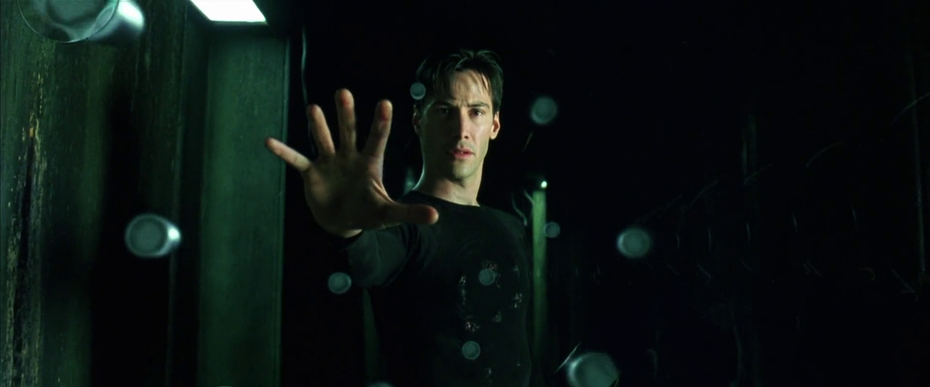
I don’t need to dodge bullets
for assessment

Slide 14
Find time to develop concept
for assessment

Slide 15
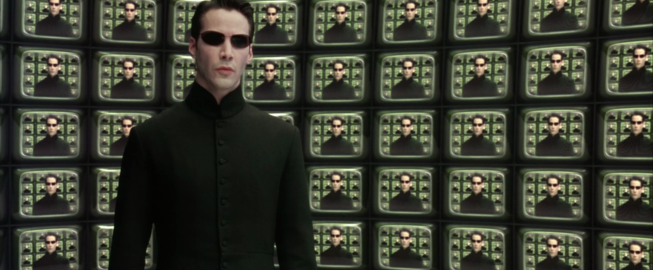
Built a proof of concept
for assessment

Slide 16
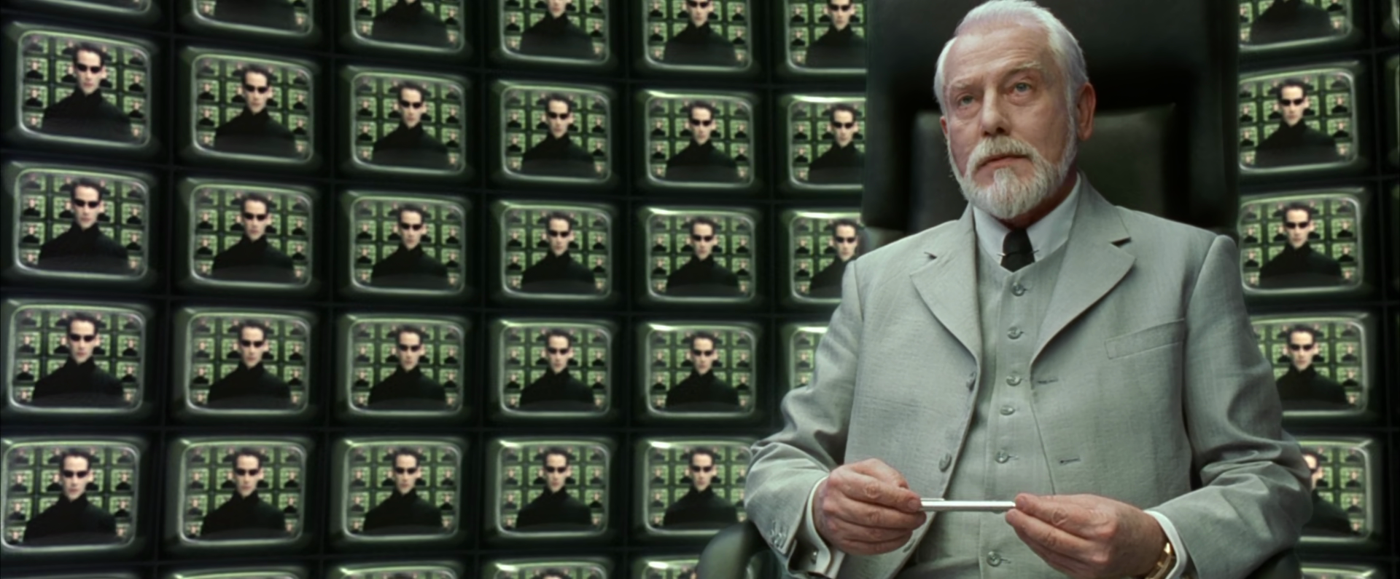
Approval to expand from ciso
for assessment

Slide 17
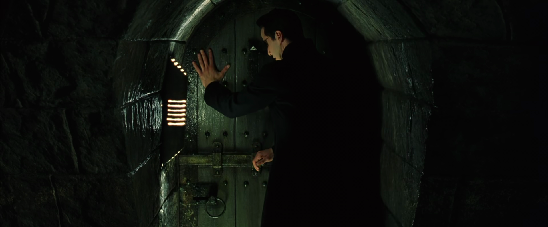
Time to find a developer
for assessment

Slide 18
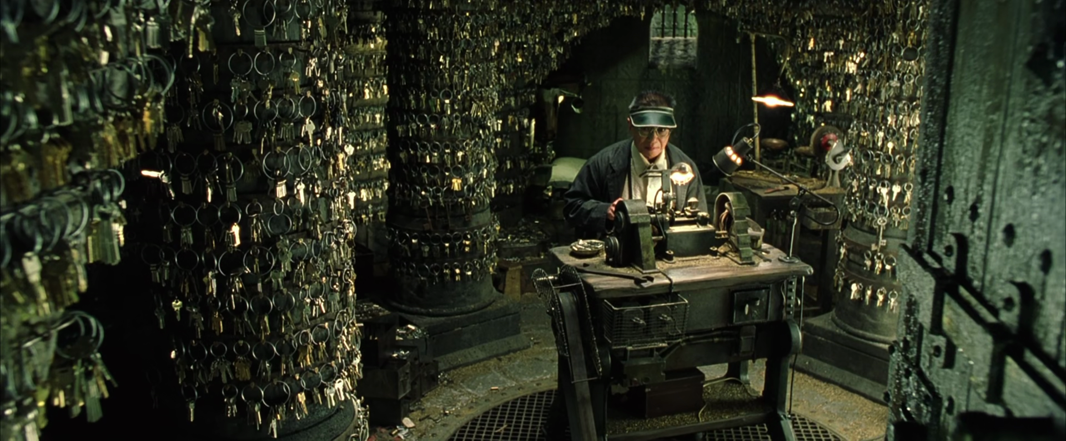
Catalyst
for assessment

Slide 19
Time to work
for assessment

Slide 20
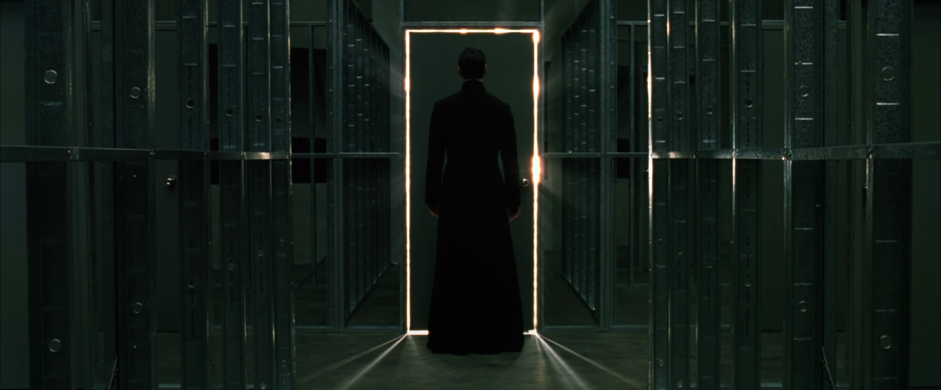
I have the key
for assessment

Slide 21
The new world
for assessment

Slide 22
So, what is the matrix.. SDLT?
A digital representation of a manual security assurance workflow
The culmination of a teams security expertise
A single point of engagement for the whole organisation
The first step in moving all security, privacy and information assurance online

Slide 23
What does it solve?
Lack of clarity around processes and deliverables
Lack of visibility with key business areas (security, privacy, information)
Reduction of last minute engagement with Security
All of nothing deliveries to security, we either get a project that has done everything or nothing
The significant amount of manual and expert work required to complete the existing security assurance workflow

Slide 24
What exists now?
A web application that manages the end-to-end security assurance process for technology deliverables. The Security Development Lifecycle Tool (SDLT)
It covers proof of concepts, software trials, software as a service adoption, product deployment, solution deployment, new version release and bug fixes
Each delivery type is captured in one of the pillars of the SDLT
Many tasks are handled by the SDLT as part of a user submission
Approvals are handled by the SDLT
Version 1 released May 2019

Slide 25
Basic user flow

Slide 26
Landing Screen

Slide 27
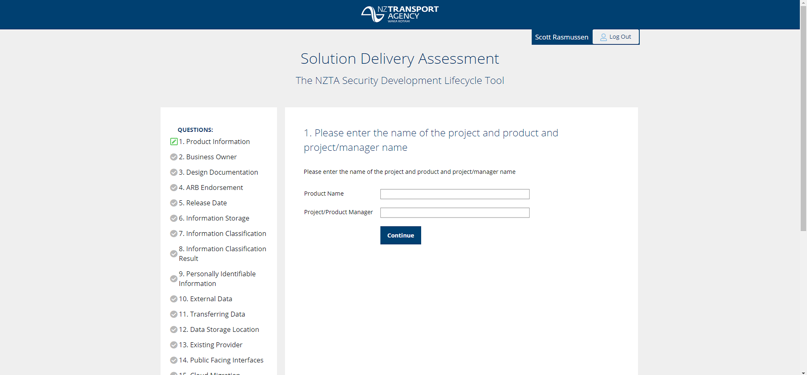
Pillar questionnaire

Slide 28
Summary screen

Slide 29
Why opensource?
To protect the IP from restrictive commercialisation
To ensure IP remains in the public space by retaining Agency ownership
To give benefits to other organisations and agencies
To encourage discussions with external parties on how to improve it
The public paid for it, so it should be available to the public
I want to look at developing the concept further myself

Slide 30
What’s Next?
More training and guidance within the Agency on how to use it
Continuous development and deployment of quality of life features
Version 2 development to finish end of September
Move remaining document based artefacts to digital workflows
A full end-to-end Security Risk Assessment
Treatment/Control management and audit/validation

Slide 31
Thank you
Find SDLT at https://github.com/nzta/sdlt
For your own install – contact Luke Percy (Catalyst)

